Slide 1
Measurement of environmental benefits
Saulo Da Silva
SIP/ASBU/2012-WP/29
Workshop on preparations for ANConf/12 − ASBU methodology
(Bangkok, 14-18/Nadi, 21-25 May 2012)

Slide 2
OVERVIEW
KPA
ASSEMBLY RESOLUTION
OPERATIONAL IMPROVEMENTS
IFSET
SUMMARY

Slide 3
KPA
ENVIRONMENT
The air navigation system should contribute to the protection of the environment by considering noise and emissions in the implementation and operation of the global air navigation system.

Slide 4
Assembly Resolution
Climate change
A37-19-Consolidated statement of continuing ICAO policies and practices related to environmental protection – Climate change

Slide 5
Assembly resolution
A37-19
Resolves:
to achieve a global annual average fuel efficiency improvement of 2 per cent until 2020.
and an aspirational global fuel efficiency improvement rate of 2 per cent per annum from 2021 to 2050.

Slide 6
Assembly resolution
A37-19
Requests ICAO to:
develop the necessary tools to assess the benefits associated with ATM improvements.

Slide 7
OPERATIONAL IMPROVEMENTS
PBN
CDO/CCO
RVSM
FUA
ETC.

Slide 8
IFSET
ICAO FUEL SAVINGS ESTIMATION TOOL
- Simple to use and scientific defendable
States will begin reporting on fuel savings from operational improvements in 2012.
Not all States have the ability to quantify these savings.

Slide 9
IFSET – WHAT IT DOES
Allows those States without modelling and/or measurement capabilities to estimate fuel savings from operational improvements.
Consistent with CAEP-approved GHG models.
Consistent with Global Air Navigation Plan.
Easy-to-use / minimal data requirements.

Slide 10
IFSET – WHAT IT DOES (Cont.)
The tool can estimate:
  Effects of shortening / eliminating level segments on departure and arrival.
  Effects of shorter routes (either in time or distance).
  Effects of cruising at different altitudes.
  Effects of reduced taxi times.

Slide 11
IFSET – WHAT IT DOES NOT
  The tool does not replace detailed modelling or measurement of fuel consumption already available in a State.

Slide 12
IFSET – HOW IT WORKS
Pre-compute aircraft performance
  Level, climb and descent fuel consumption
  By group of aircraft type
  In 1000 foot intervals

Slide 13
IFSET – HOW IT WORKS – USER INPUT
Fleet mix defined for baseline and post-implementation scenario
  Aircraft type group
  “Remaining flight distance”(as a surrogate for weight)
User selects “elements” to define the baseline and “new” procedure
Tool estimates the change in total fuel consumption between the 2 scenarios

Slide 14
IFSET – SCHEDULE
December 2011 – ICAO releases the first version of the IFSET. (SL AN 13/61-12/4, 6Jan 2012)
2011/2012 – Workshops on how to use IFSET.
2012 – States/ANSPs start estimation and reporting fuel savings accrued from operational improvements.
Dec 2012 – ICAO releases the environment report with the results obtained.

Slide 15
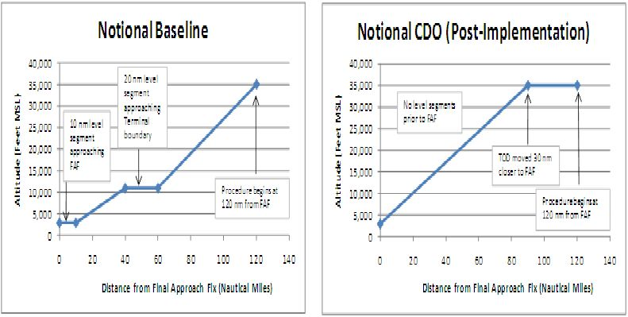
IFSET – example

Slide 16
IFSET – example
IFSET

Slide 17
SUMMARY
KPA
ASSEMBLY RESOLUTION
OPERATIONAL IMPROVEMENTS
IFSET

Slide 18


